Slide 1
Machine Learning
Lecture 10

Slide 2
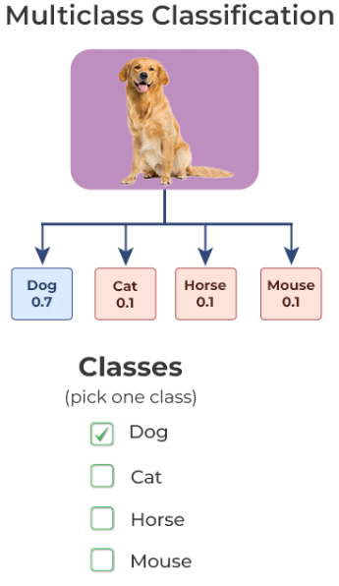
Multiclass Classification
If the number of classes is two, the task is known as binary classification (0 or 1), i.e., all the data points will lie in either of the two classes only.
If the number of classes is more than two, it is known as a multiclass classification problem.
The basic assumption of a multi-class classification in machine learning is that each data point will belong to only one of the N classes.

Slide 3
Examples
Face expressions classification
Plant species classification
Optical character recognition
classification of news in different categories
classifying books according to the subject
differentiating between several types of cancer from an MRI
Classifying e-commerce items into specific categories (e.g., Electronics, Clothing, Home Goods) etc.

Slide 4
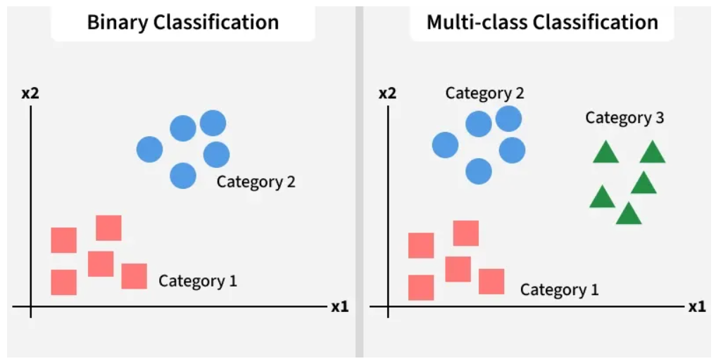
Many machine learning algorithms can be used to train a multiclass classifier but not all as standard algorithms such as logistic regression, support vector machines (SVM) are designed only for binary classification tasks.
However, we can use strategies to leverage these traditional multiclass classification algorithms.
ML algorithms like logistic regression and SVM have been designed to solve binary classification problems. The entire task is broken into multiple binary classification problems using strategies like one-vs-rest or one-vs-all to use them in multiclass classification.

Slide 5
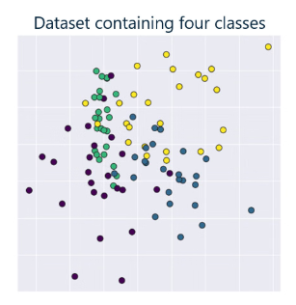
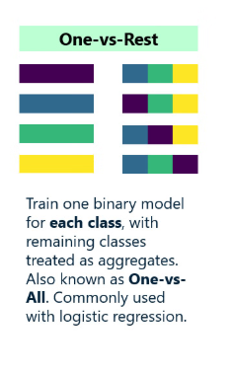
One-vs-all/One-vs-rest

Slide 6
As the name suggests, we train a binary classifier for every class where the class distribution is the target class versus the rest of the classes.
For example, if you are working on a problem of predicting whether the given fruit is an apple, mango, or banana, you will train three binary classifiers.
Classifier A: [apple] v/s [mango, banana]
Classifier B: [mango] v/s [apple, banana]
Classifier C: [banana] v/s [apple, mango]
Voting is used to predict the final class, i.e., the binary classifier predicting the target class with the highest confidence is given as the final output and is commonly used with Logistic Regression.

Slide 7
One-vs-all: How it works?
Split the training set into three separate binary classification problems
i.e. create a new fake training set
Triangle (1) vs crosses and squares (0) h_{θ}¹(x)
P(y=1 | x₁; θ)
Crosses (1) vs triangle and square (0) h_{θ}²(x)
P(y=1 | x₂; θ)
Square (1) vs crosses and square (0) h_{θ}³(x)
P(y=1 | x₃; θ)
Train a logistic regression classifier h_{θ}^{(i)}(x) for each class i to predict the probability that y = i
On a new input, x to make a prediction, pick the class i that maximizes the probability that h_{θ}^{(i)}(x) = 1

Slide 8
